Slide 1

Title Slide
How Feedback and Plain Language Helped the IRS Respond to
COVID-19
Notes:
Slide 1 (TITLE SLIDE) –
My name is Jose Vejarano, Chief Content Strategist for IRS.gov
Thank you for having me join this year’s Second Annual Plain Language Summit. I have the pleasure to speak to you about
How listening to feedback and embracing plain language best practices helped the U.S. Internal Revenue Service respond to COVID-19

Slide 2
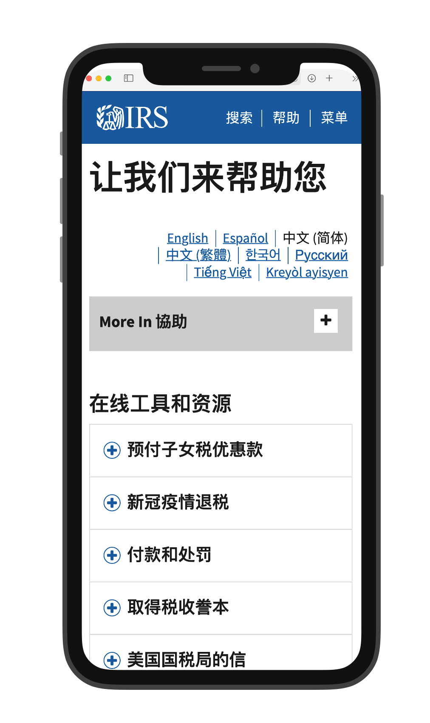
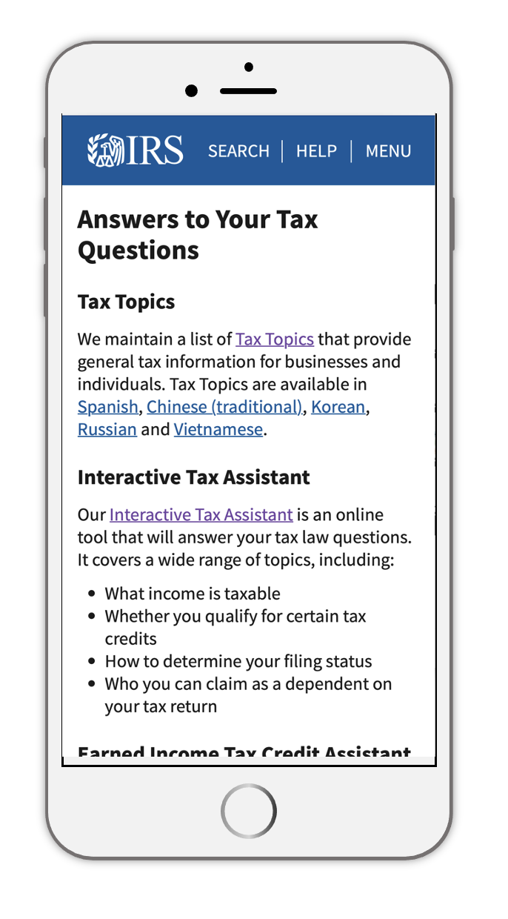
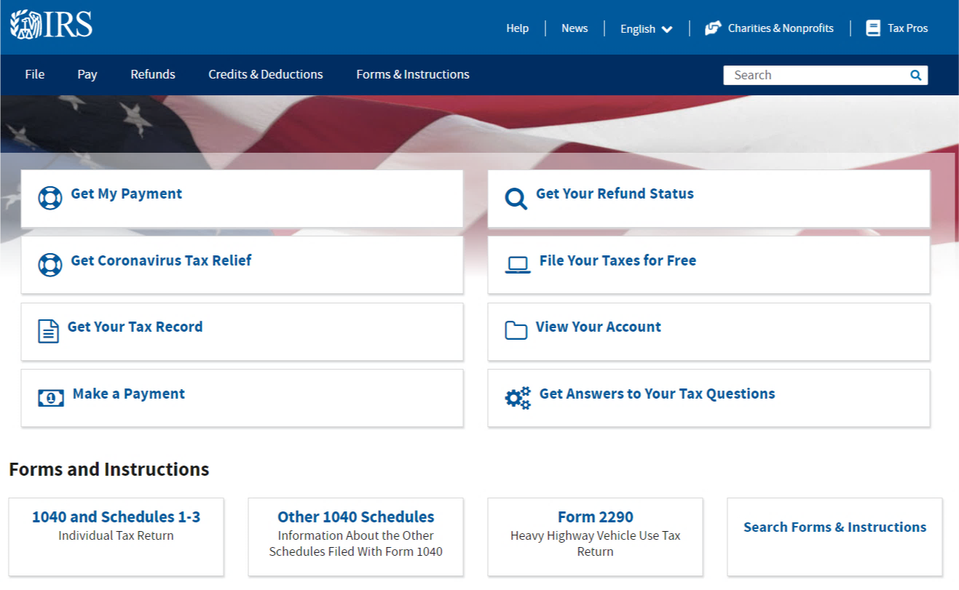
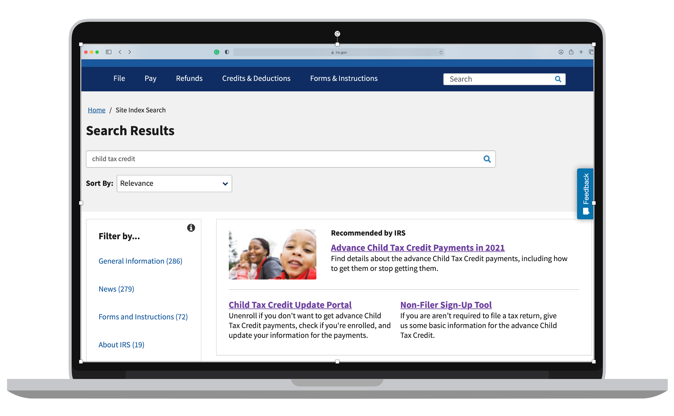
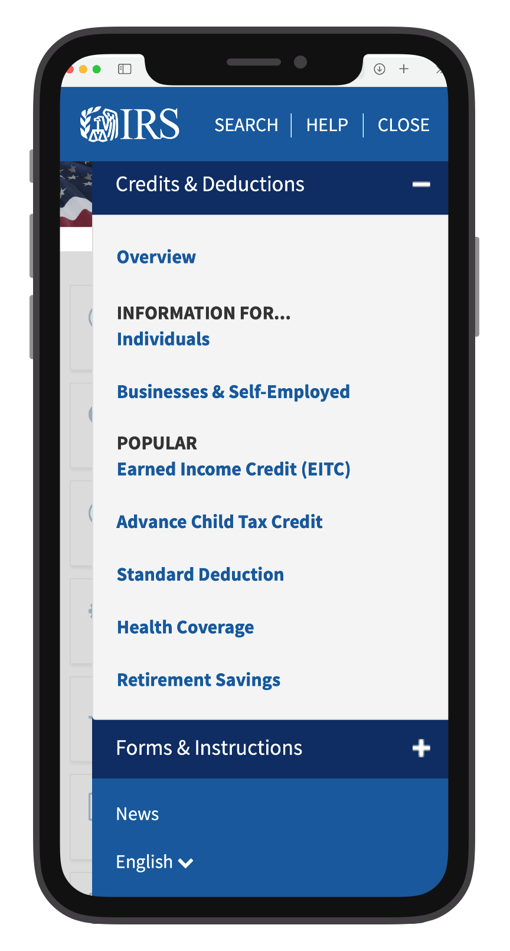
IRS.gov Homepage
2
Notes:
Slide 2 – IRS.gov Homepage
IRS.gov is practical. Task-oriented. No one goes there for fun.

Slide 3

IRS.gov Analytics
1.7B sessions in 2020
30,000+ pages
140,000 multimedia files
3
Notes:
Slide 3 – IRS.gov website info

Slide 4
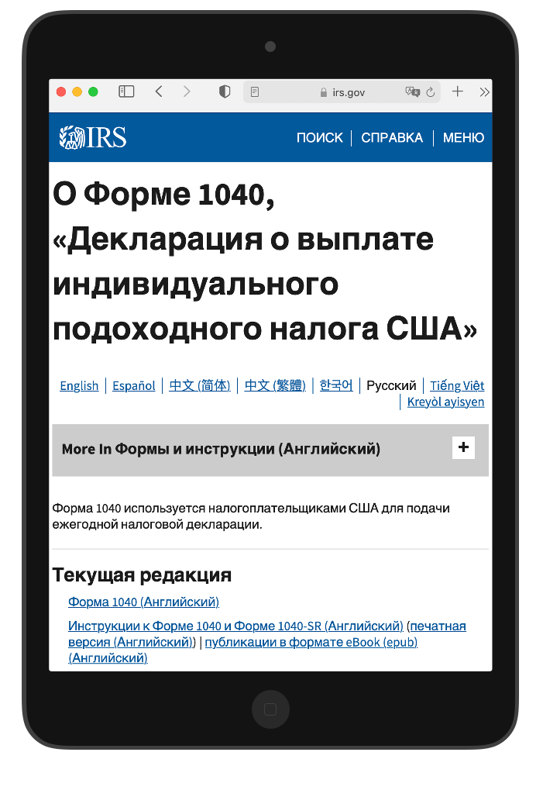
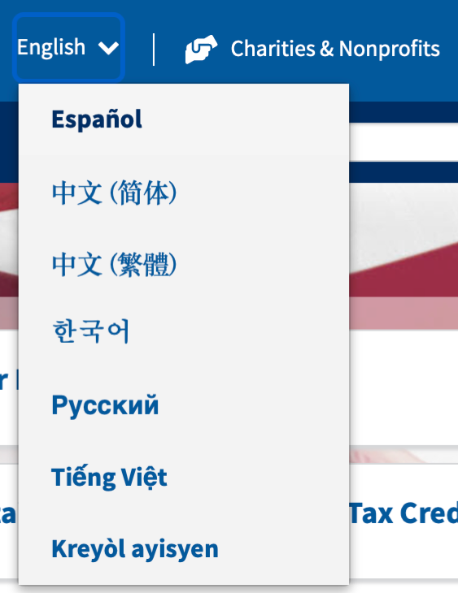
IRS.gov Multilingual Pages
Multilingual Pages
4
Notes:
Slide 4 – Multilingual Pages
We offer robust support in seven languages - Spanish, Korean, Vietnamese, Russian, Haitian-Creole and Simplified and Traditional Chinese. Approximately 7,400 pages
Basic Tax information is offered in 20 languages in addition to English

Slide 5
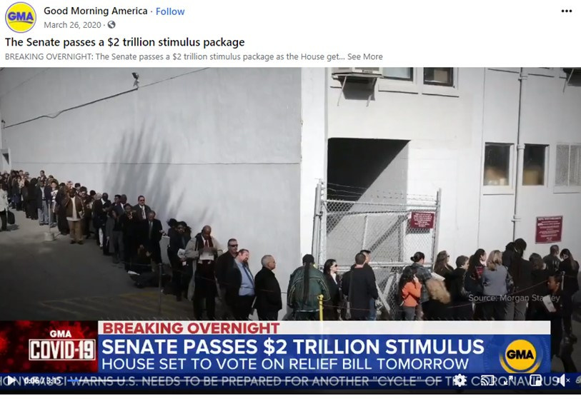
News Coverage of CARES Act
Headshot of José
5
Notes:
Slide 5 - News Coverage
The early days of the coronavirus pandemic brought economic hardship to millions of Americans.
March 26 several morning news shows:
Featured images of long unemployment lines
Reported that the Stimulus package had passed the Senate (people did not know what this meant and thought the legislation was signed)
Told people to go to IRS.gov and sign up for Direct Deposit right now, before legislation was signed.

Slide 6
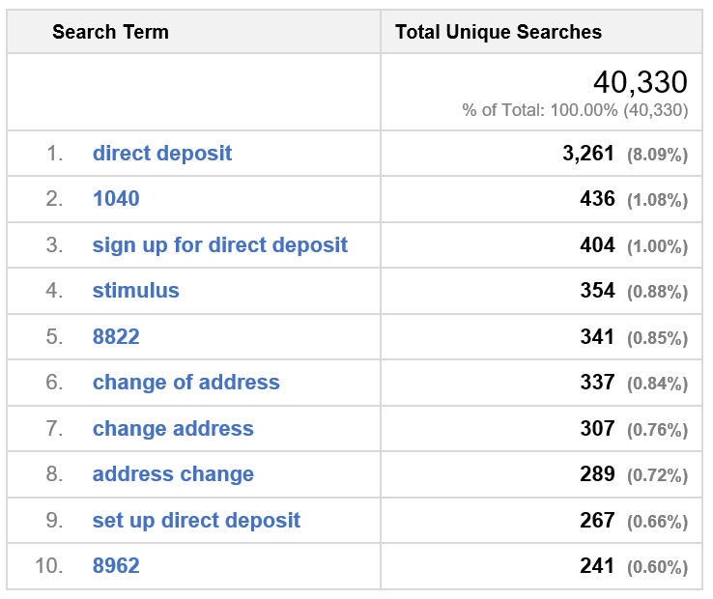
Impact on Search Terms
“… there have been 8x more searches for ‘direct deposit’
today than any other term.”
Internal email, March 26, 2020, 9:42 a.m.
6
Notes:
Slide 6 - Search Results
We were prepared because we were already listening.

Slide 7
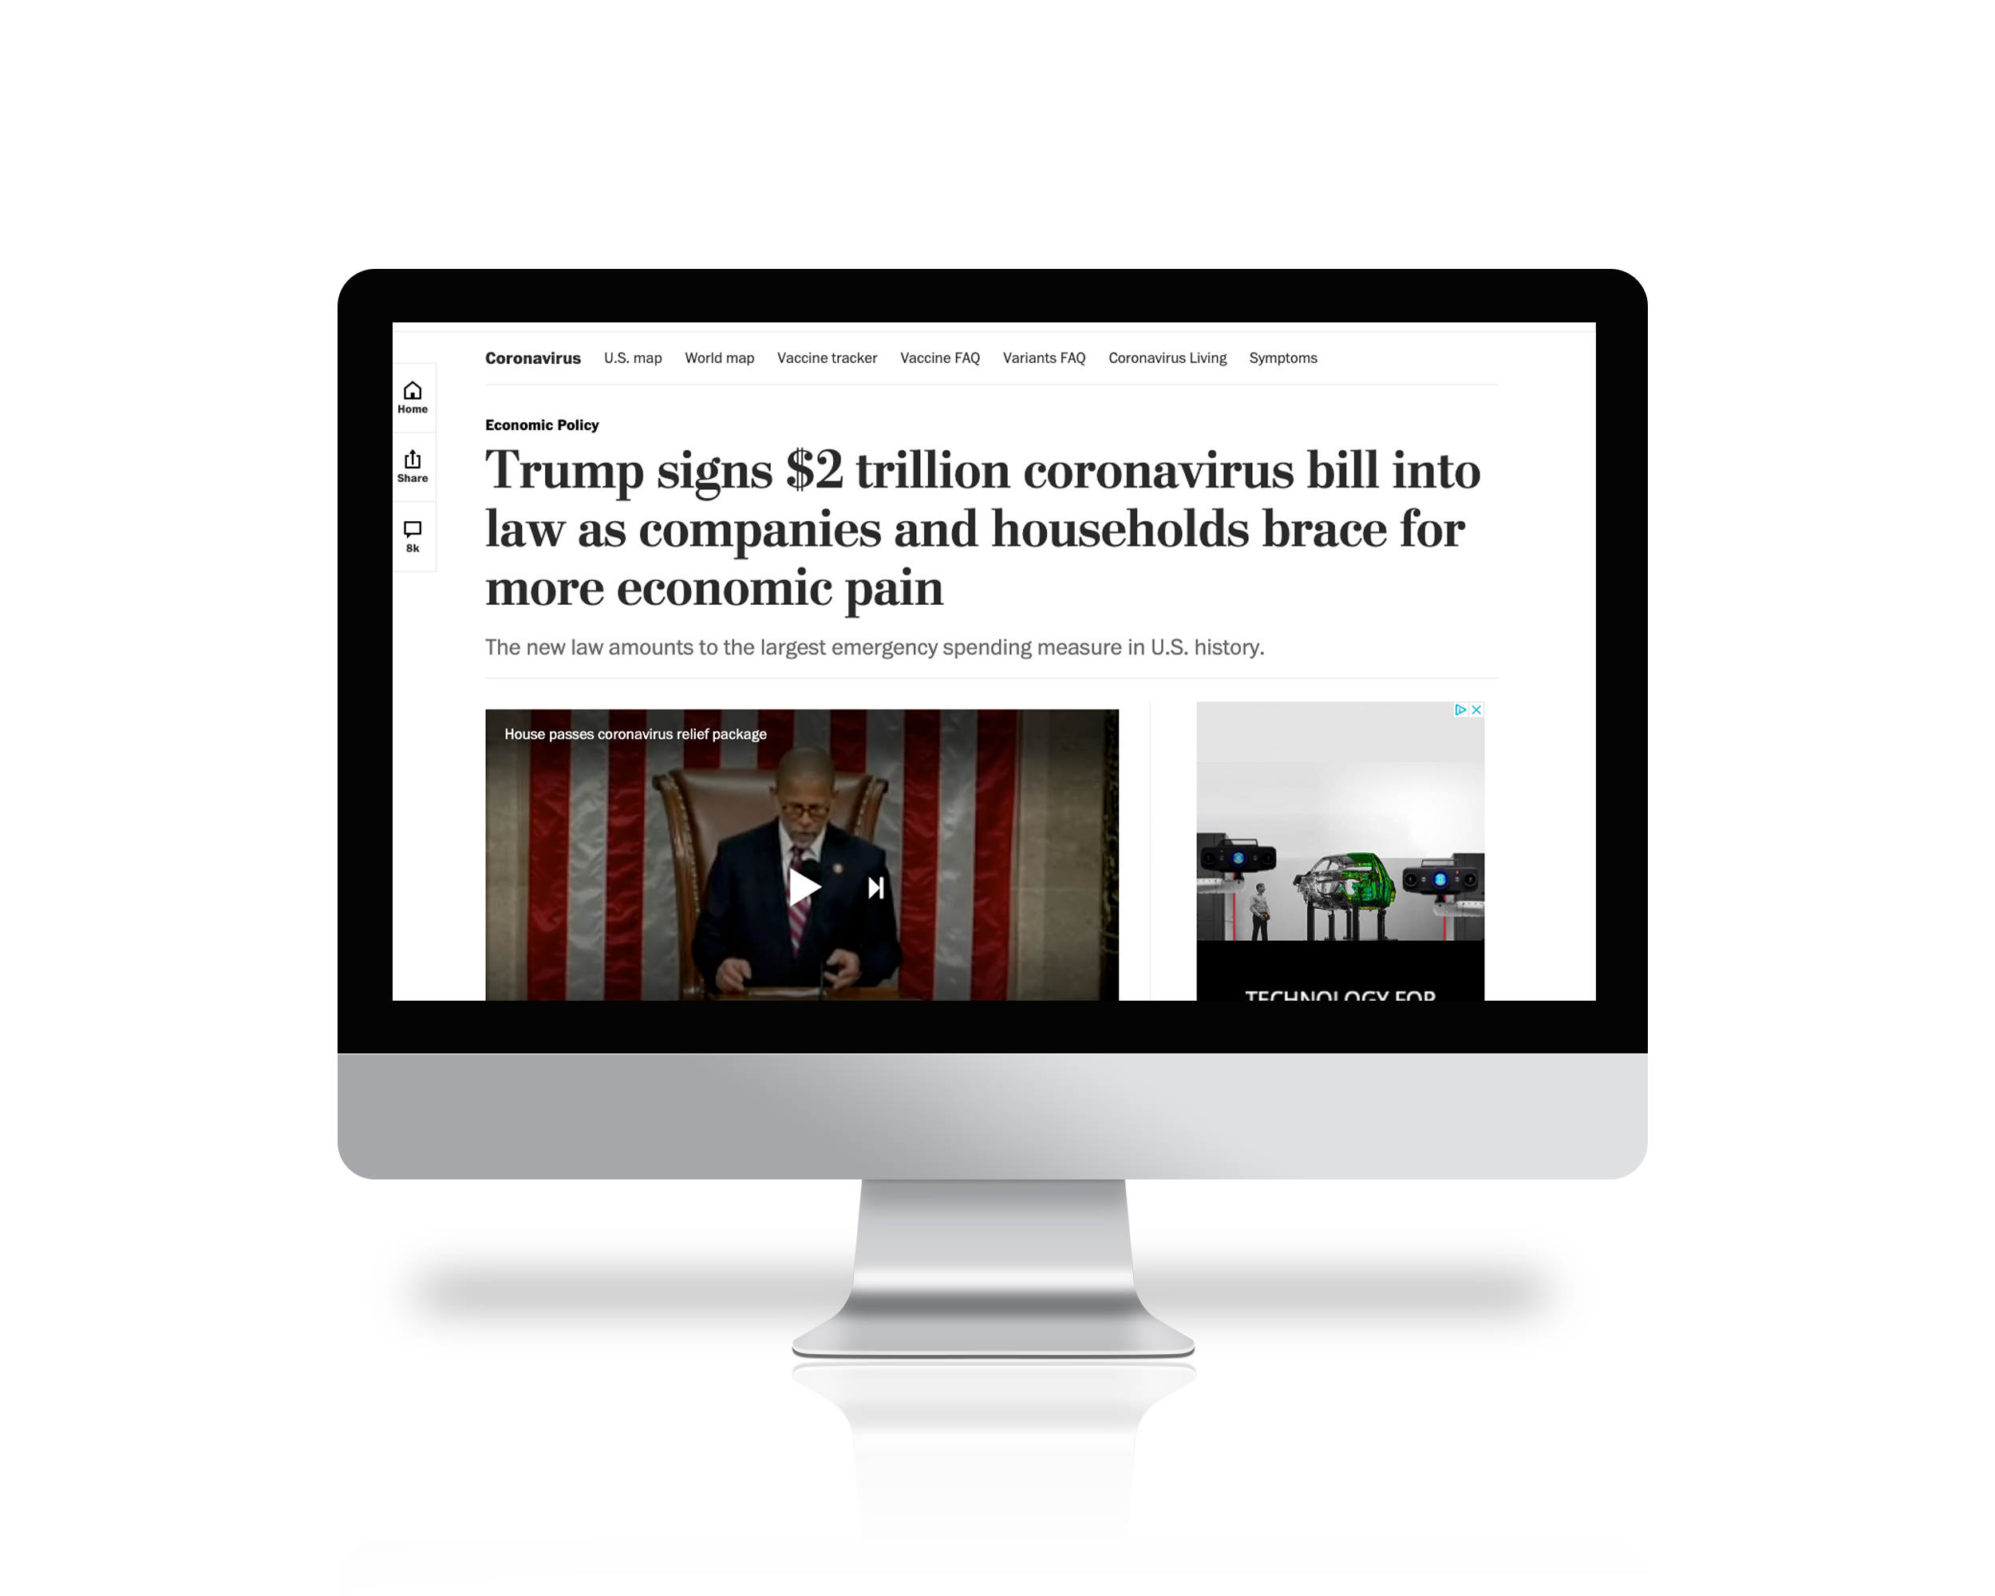
Impact of CARES Act
7
Image: The Washington Post, 03/27/2020

Slide 8
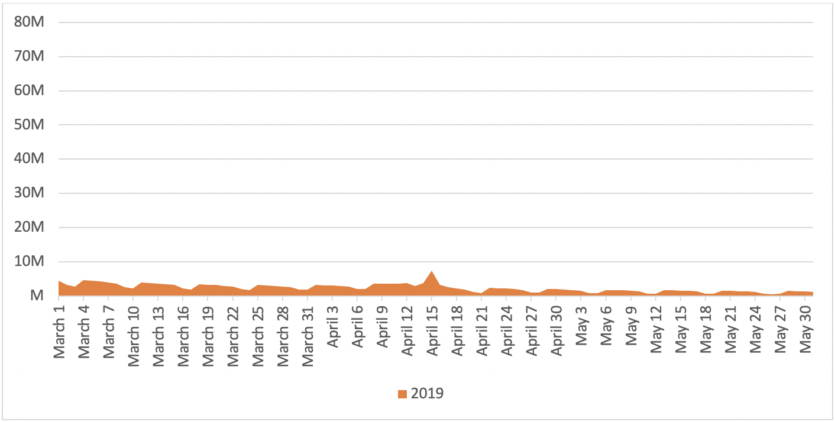
IRS.gov Sessions 2019
IRS.gov Sessions Per Day
8
Notes:
Slide 8 – IRS.gov Sessions per Day for 2019
For context, here’s what our traffic looked like before COVID.

Slide 9
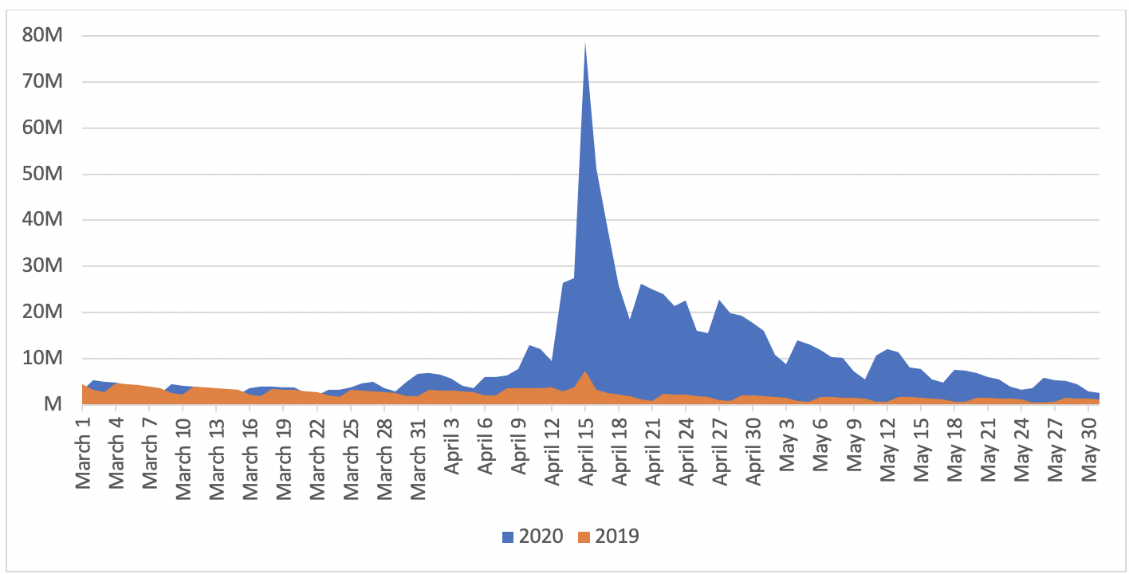
IRS.gov Sessions 2020
IRS.gov Sessions Per Day
9
Notes:
People were coming to us in record numbers for answers and help. We had to
Develop information fast
Get it approved even faster

Slide 10




Collaborative Review Process
Collaborative Review Process
Listen
to what people are saying
Respond
to their feedback
Review
with our stakeholders
Share
daily actions and decisions
10

Slide 11
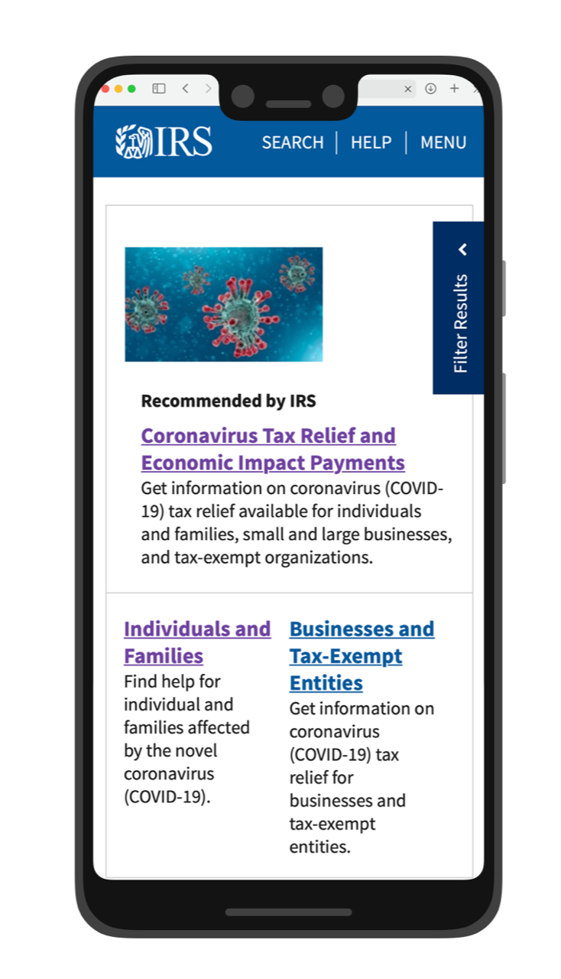
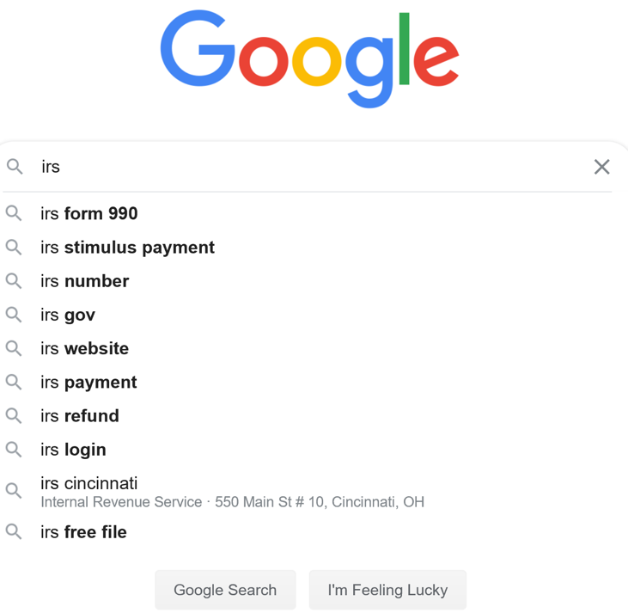
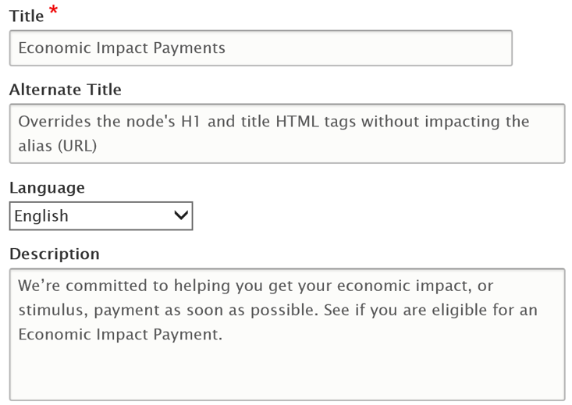
Case Study: Meta Descriptions and Best Bets
Example:
Meta Descriptions and Best Bets
11

Slide 12
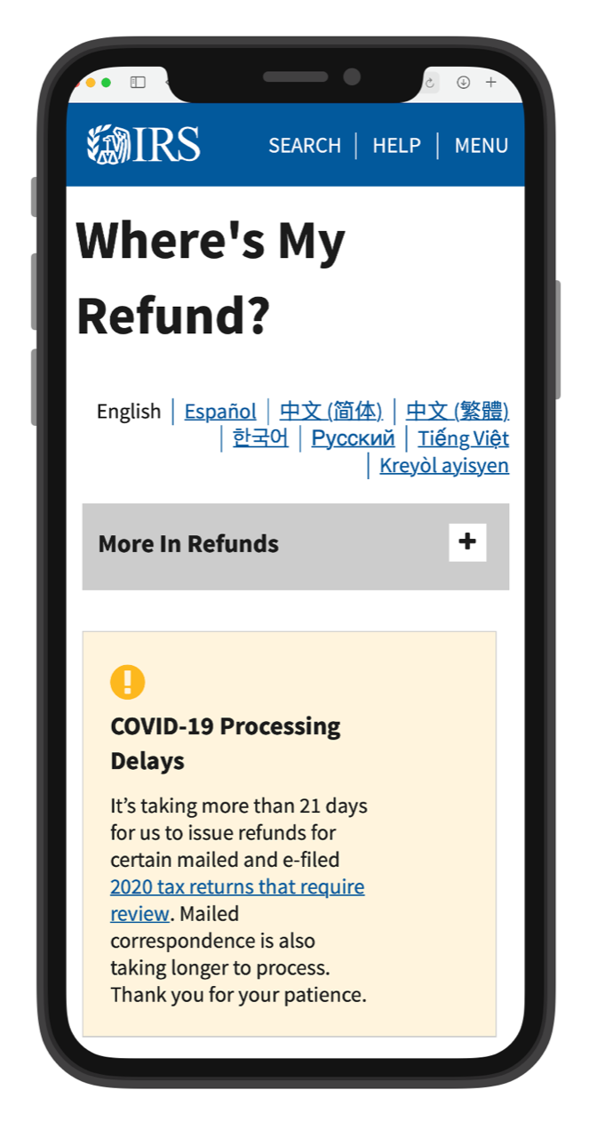
Case Study: Alerts
Example: Alerts
The IRS expects to issue all refunds for 2019 individual tax returns in 2020, where there are no issues with the return. For refunds that cannot be issued in 2020 because the tax return is being corrected, reviewed or awaiting correspondence from a taxpayer, the refund will be issued as a paper check in 2021 per our normal processes. Taxpayers are encouraged to continue to check Where’s My Refund for their personalized refund status.
Proposed Text,
December 1, 2020
12

Slide 13




Plain Language Lessons Learned
Lessons Learned
Listen
Tune in to user needs
Learn
Make changes along the way
Connect
Use words people understand
Lead
Don’t wait for others to do it
13
Notes:
Slide 13 - Lessons Learned
Lesson 1. Listen:
Our audience goes beyond taxpayers
We listened to site data, surveys, social media, traditional media
Answered real questions people were asking
Lesson 2 Learn.
Our first efforts don’t have to be perfect
We don’t always hear what we want
We can start with imperfect messaging and evolve
Lesson 3 Connect.
We couldn’t always use the words we wanted
We had to advocate for plain language
Lesson 4 Lead.
Look for the easy wins
Find ways to get the work done

Slide 14

Thank You
Thank you!
José Vejarano
Chief, Content Strategy
IRS.gov
Listen
Learn
Connect
Lead
Notes:
Slide 14 - Thank you

